Slide 1
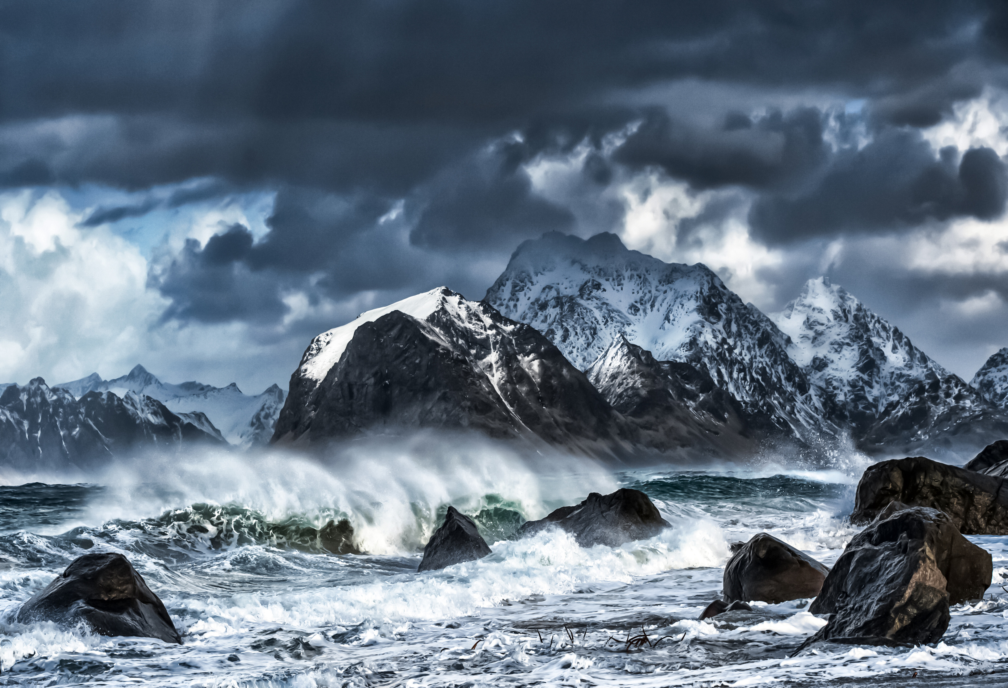

WEATHER CONDITIONS & CLIMATE CHANGE WITH CLIMATEWINS
Asad Agha
August, 2025

Slide 2
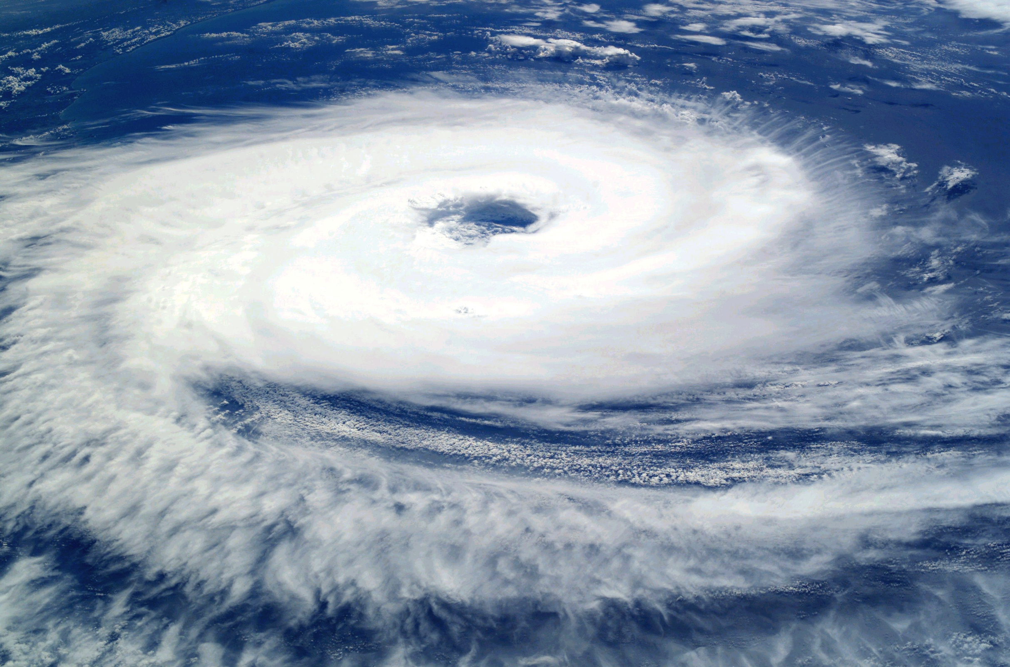
OBJECTIVE
Identify unusual European weather patterns, assess if these anomalies are increasing, and predict the safest regions for habitation over the next 25 to 50 years.

Slide 3
Thought experiments
1
2
3
Analyze if unusual weather patterns in Europe are increasing over time.
Detect significant deviations in Europe’s weather from historical norms.
Forecast future weather and identify the safest European regions to live.

Slide 4
Algorithm Overview: Machine Learning tools
Random Forests
What They Do:
Combines multiple decision trees to improve predictive accuracy.
Application:
Feature importance analysis and risk assessment for identifying safe regions.
CNN & RNN
Convolution Neural Networks
& Recurrent Neural Networks
What They Do:
CNNs detect spatial patterns; RNNs capture temporal dependencies in sequential data.
Application:
Identify deviations in weather patterns and forecast future conditions.
GAN
Generative Adversarial Network
What They Do:
GANs create synthetic data by putting two neural networks against each other.
Application:
Simulate future weather scenarios to predict potential climate changes.

Slide 5
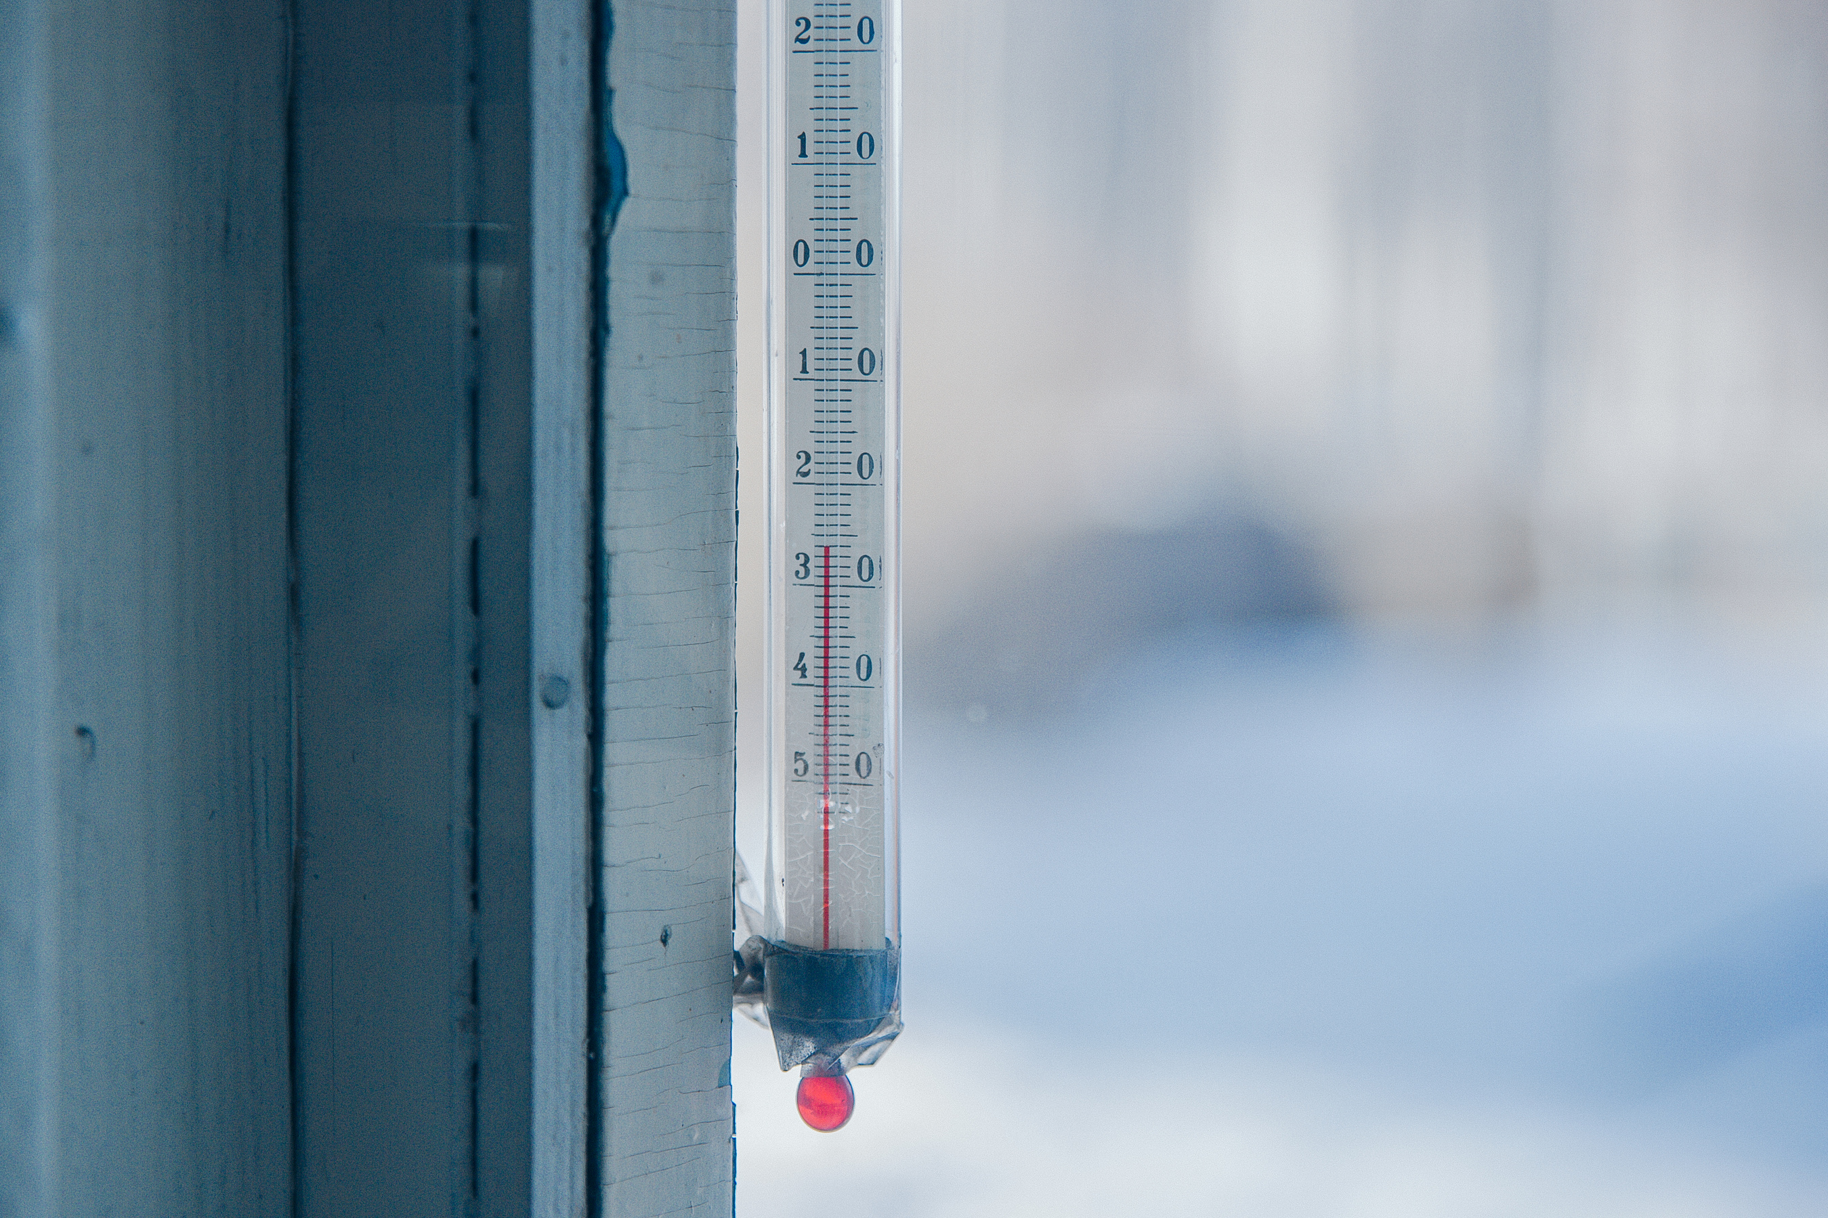
1: Assessing trends in Unusual Weather Patterns
Thought Experiment: Analyze historical data to determine if the frequency and intensity of unusual weather patterns are increasing, indicating shifts in climate behavior.
Data Collection: Historical time-series data of weather anomalies .
Algorithms:
RNNs (LSTMs) & Random Forest: Used to analyze sequence data to detect trends and temporal patterns over time. Used to provide feature importance and to confirm trend shifts in weather data.
Reason: LSTMs capture temporal dependencies; Random Forests handle tabular data and surface feature importance to explain changes.

Slide 6
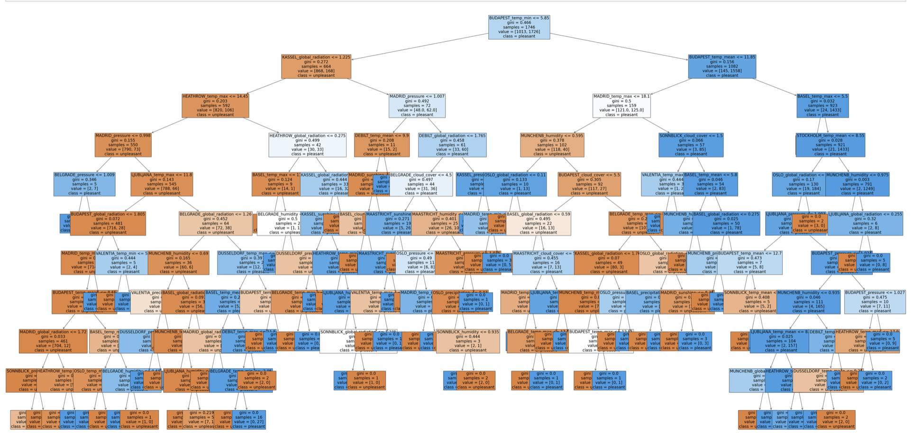
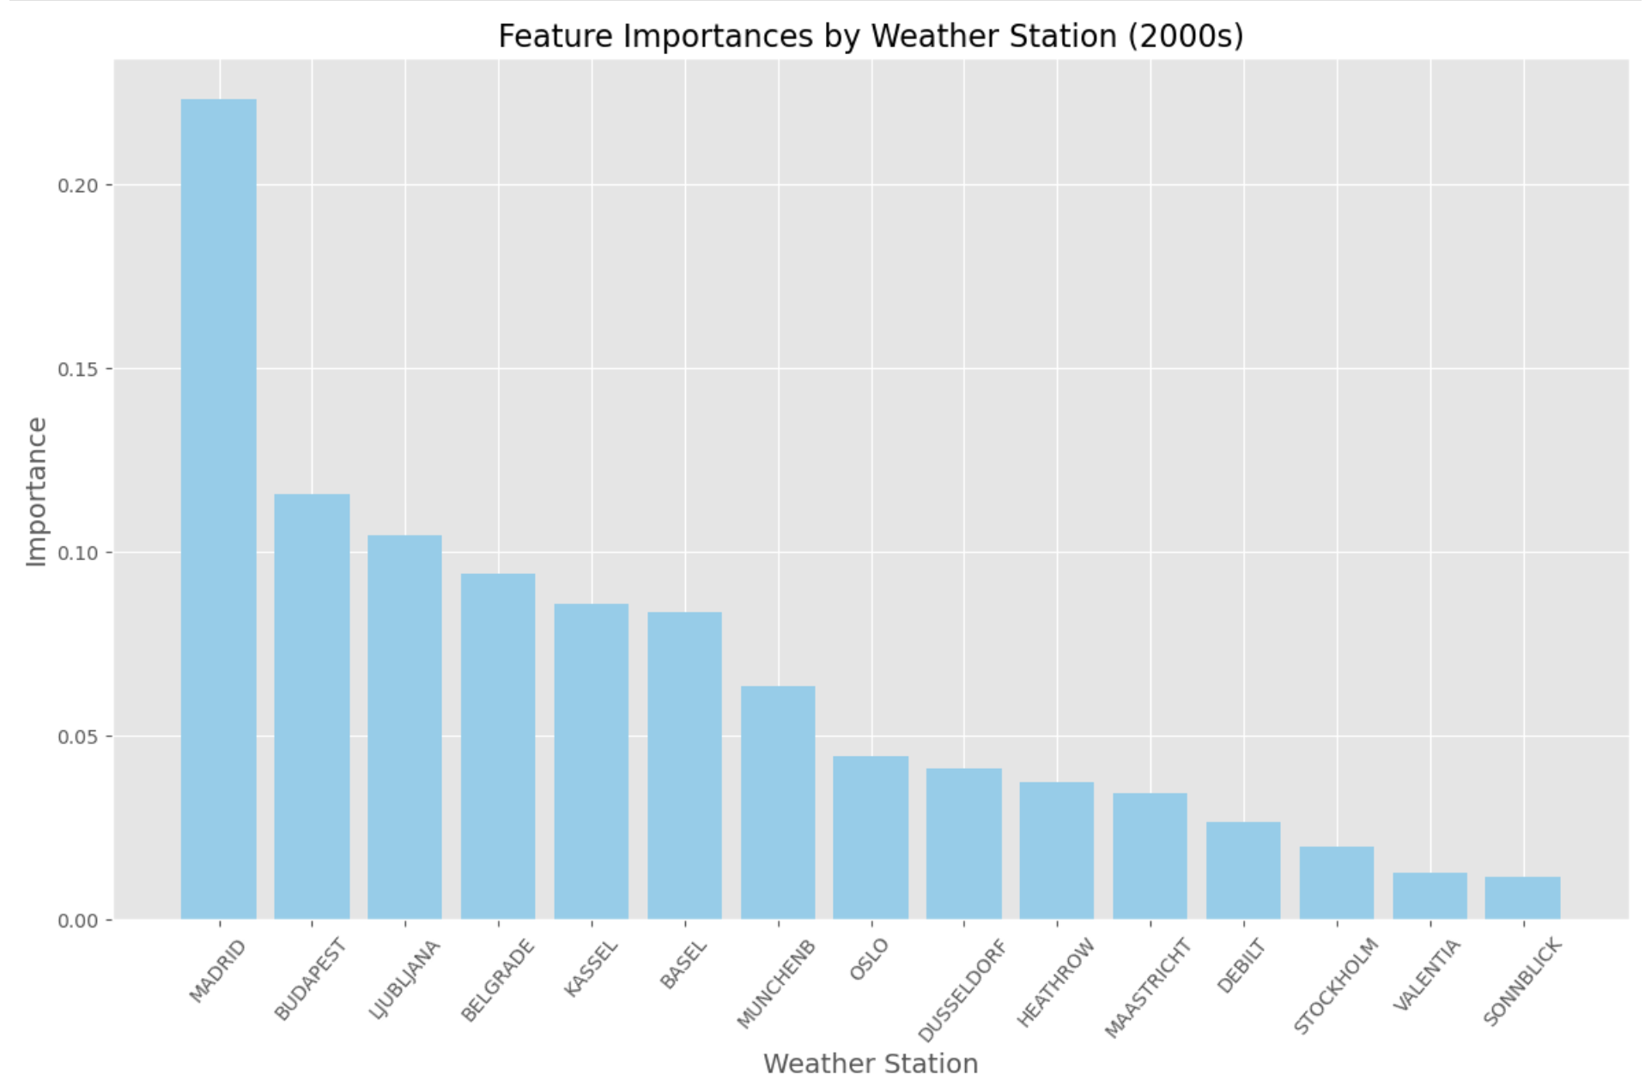
1: Assessing trends in Unusual Weather Patterns
Decision tree from random forest classifier using data from the 2000s. Accuracy of 96%.
Madrid, Budapest, and Ljubljana are weather stations that have the most impact on the model.

Slide 7
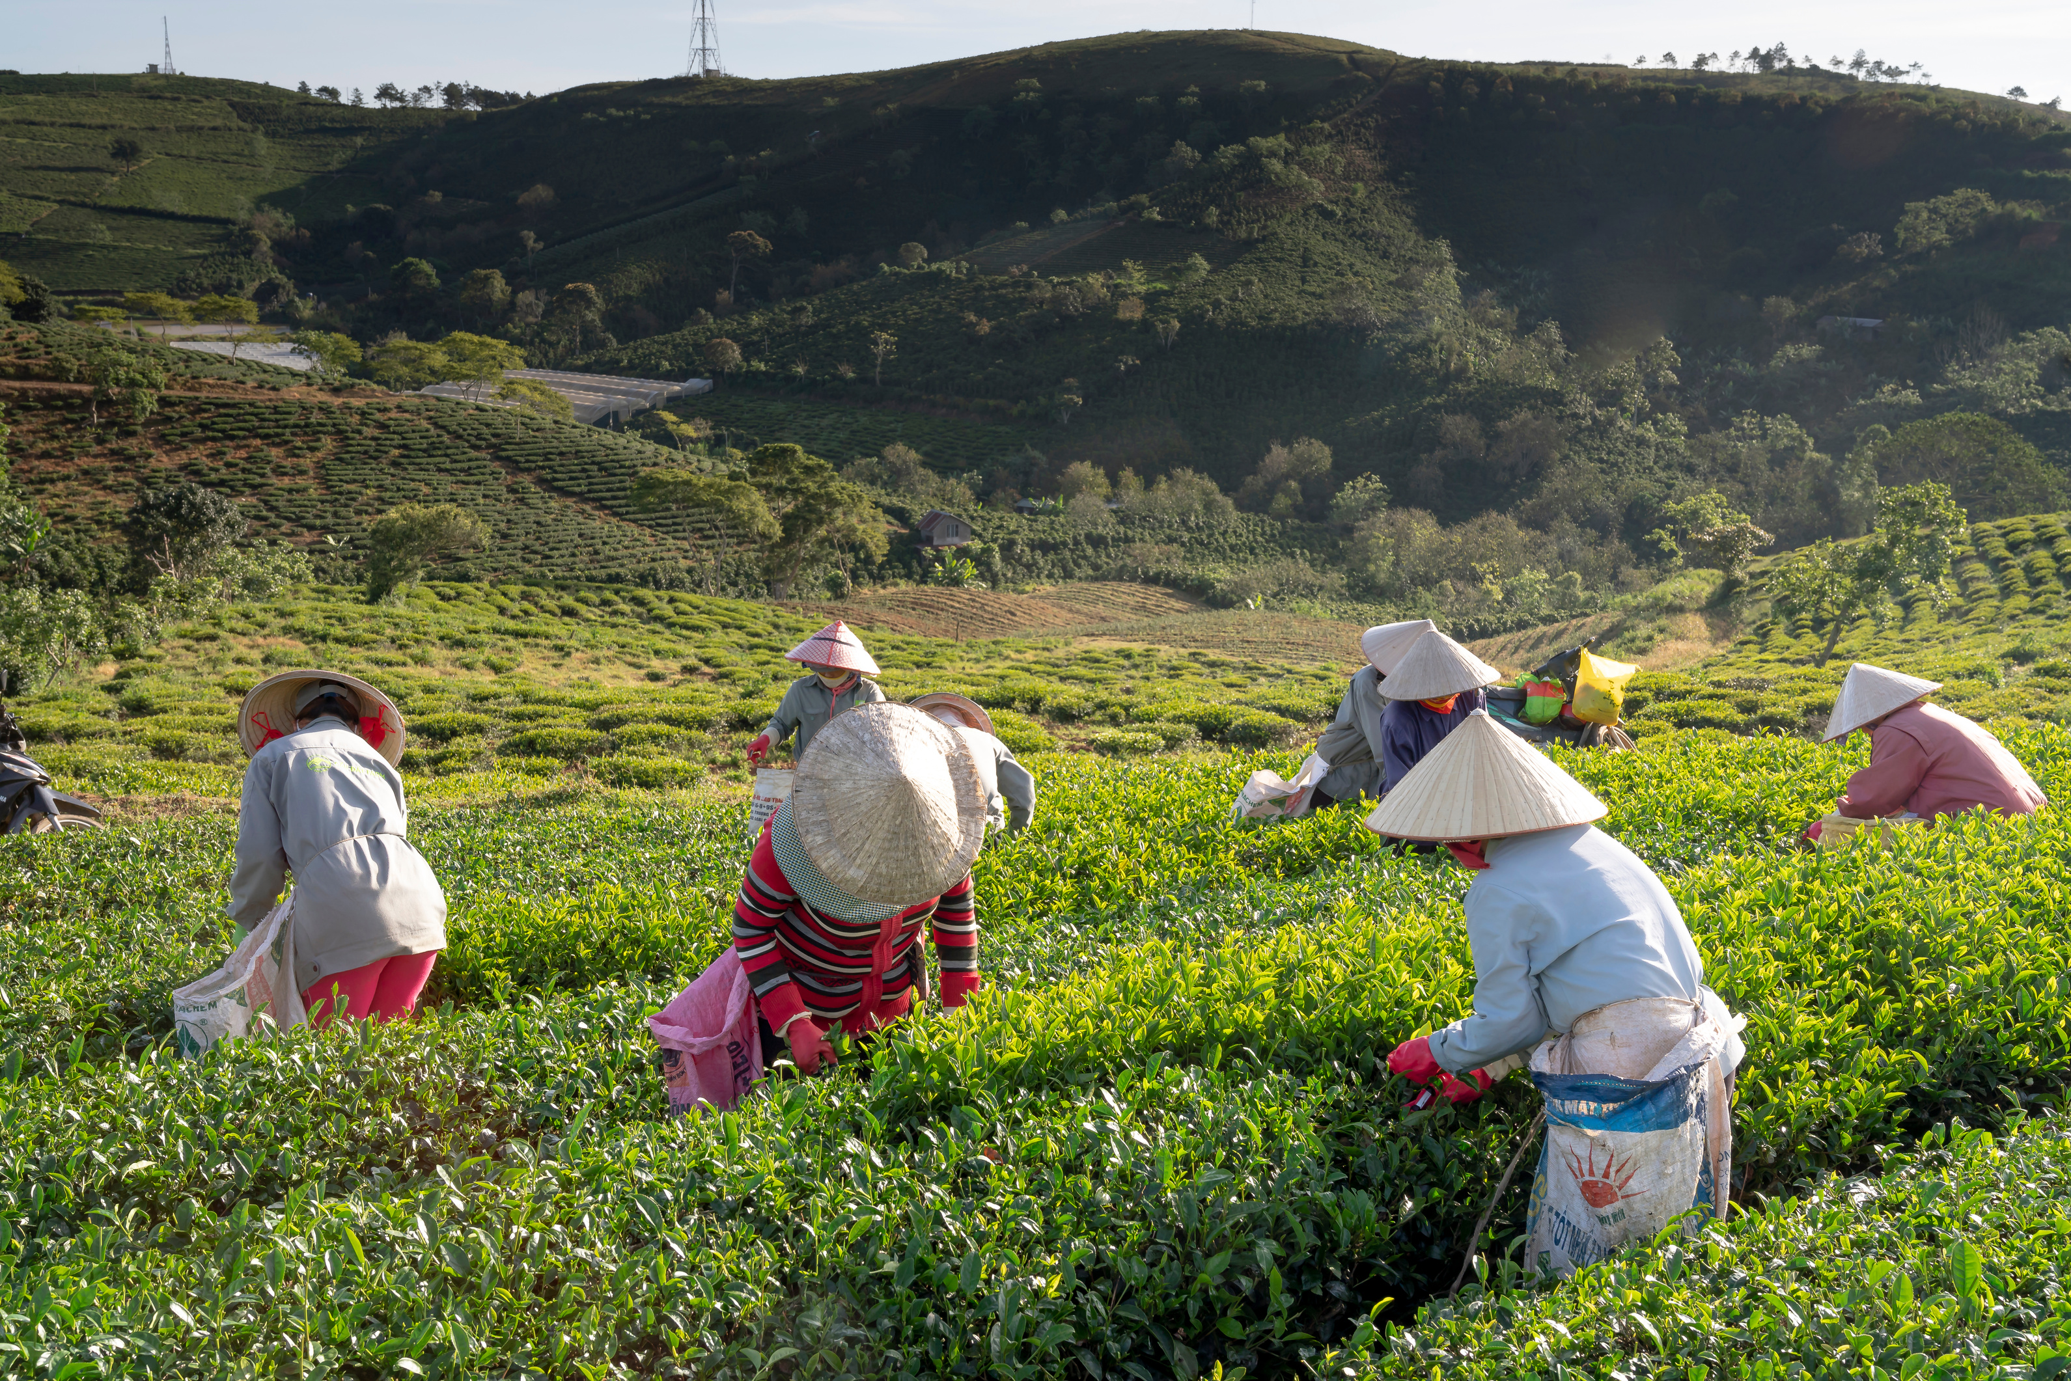
2: Identifying Deviations in Weather Patterns
Thought Experiment: Investigate and identify weather patterns in Europe that significantly deviate from historical regional norms to understand potential climate change impacts.
Data Collection: historical weather data from various regions in Europe over the last 100 years.
Algorithms:
CNNs: Used to analyze spatial data to detect patterns and anomalies across different regions.
Reason: Excels at extracting spatial features from images, making it ideal for classifying weather photos into categories.

Slide 8
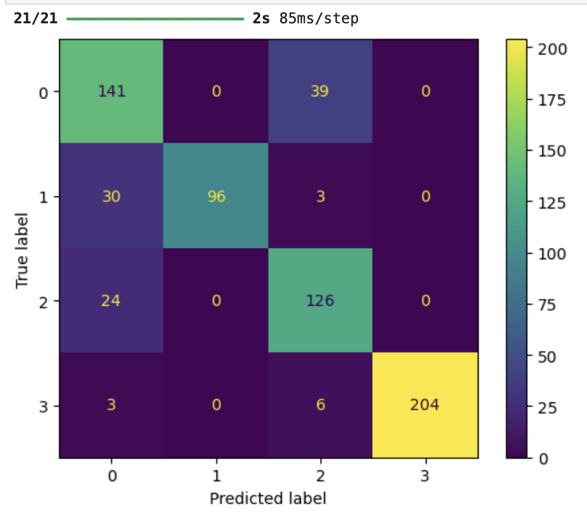
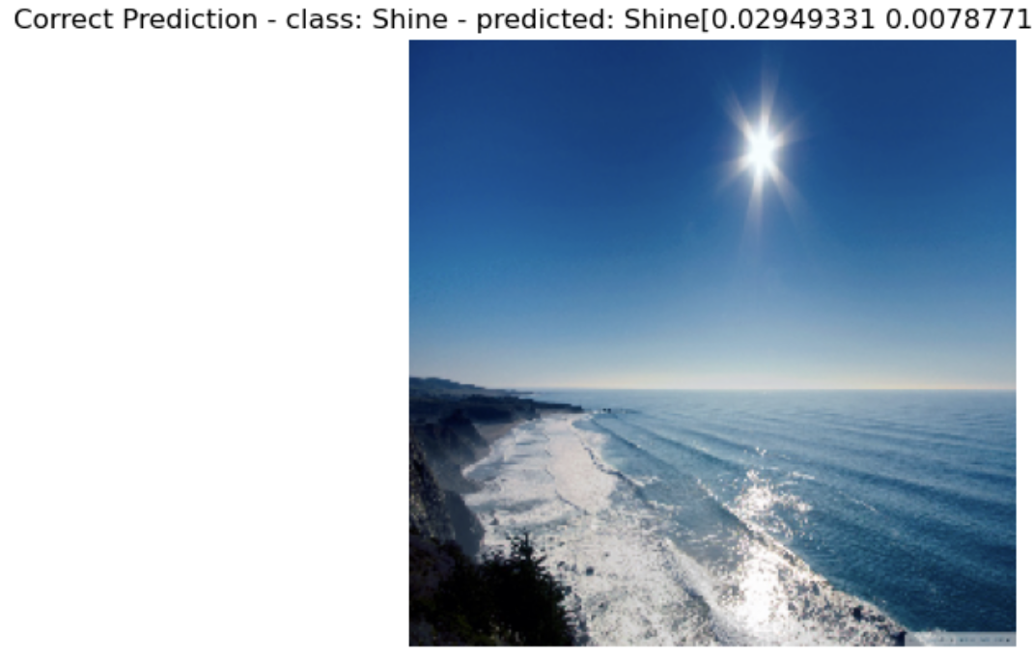
2: Identifying Deviations in Weather Patterns
Confusion Matrix derived from CNN model categorizing weather. The accuracy of the model is 88%.
Prediction display showing an example of a correct prediction.

Slide 9

3: Projecting future climate scenarios and safe regions
Thought Experiment: Generate future weather condition scenarios for the next 25 to 50 years and identify regions in Europe that will be safest for habitation based on these projections.
Algorithms:
CNN: Spatial data analysis and pattern recognition.
Random Forests: Conduct risk assessments, factor in predicted weather conditions and assess regional safety.

Slide 10
3: Projecting future climate scenarios and safe regions
Algorithm:
GANS: Use GANSs to simulate various weather patterns and scenarios, such as temperature shifts or precipitation changes over time.
Approach: Create synthetic weather maps to explore long term predictions (e.g. 25 to 50 years).
Expected Outcome: A tool that visualizes potential future climates, allowing stakeholders to plan for extreme scenarios.

Slide 11

Summary & Recommendations
ClimateWins can use a combination of Random Forest, CNNs, and GANs for predicting and simulating future weather conditions.
CNNs can be used for analyzing satellite data and weather imagery to improve real-time classification of weather conditions.
Random Forest models can be used for immediate analysis, and to determine feature importance and identify key predictors of abnormal weather patterns.
Furthermore, ClimateWins will also find value in investing in developing GANs for simulating future climate scenarios.

Slide 12
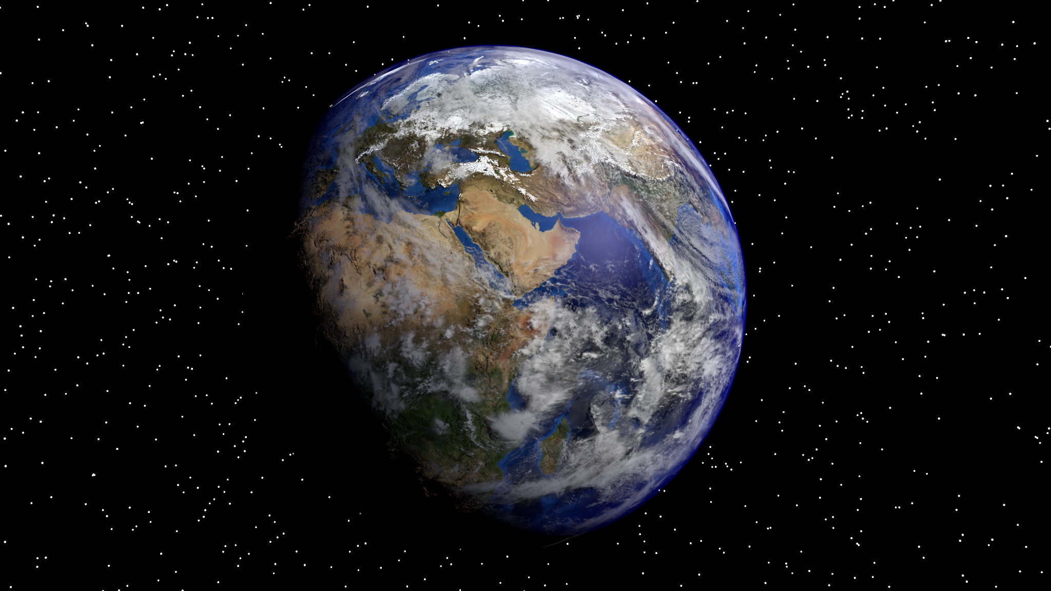
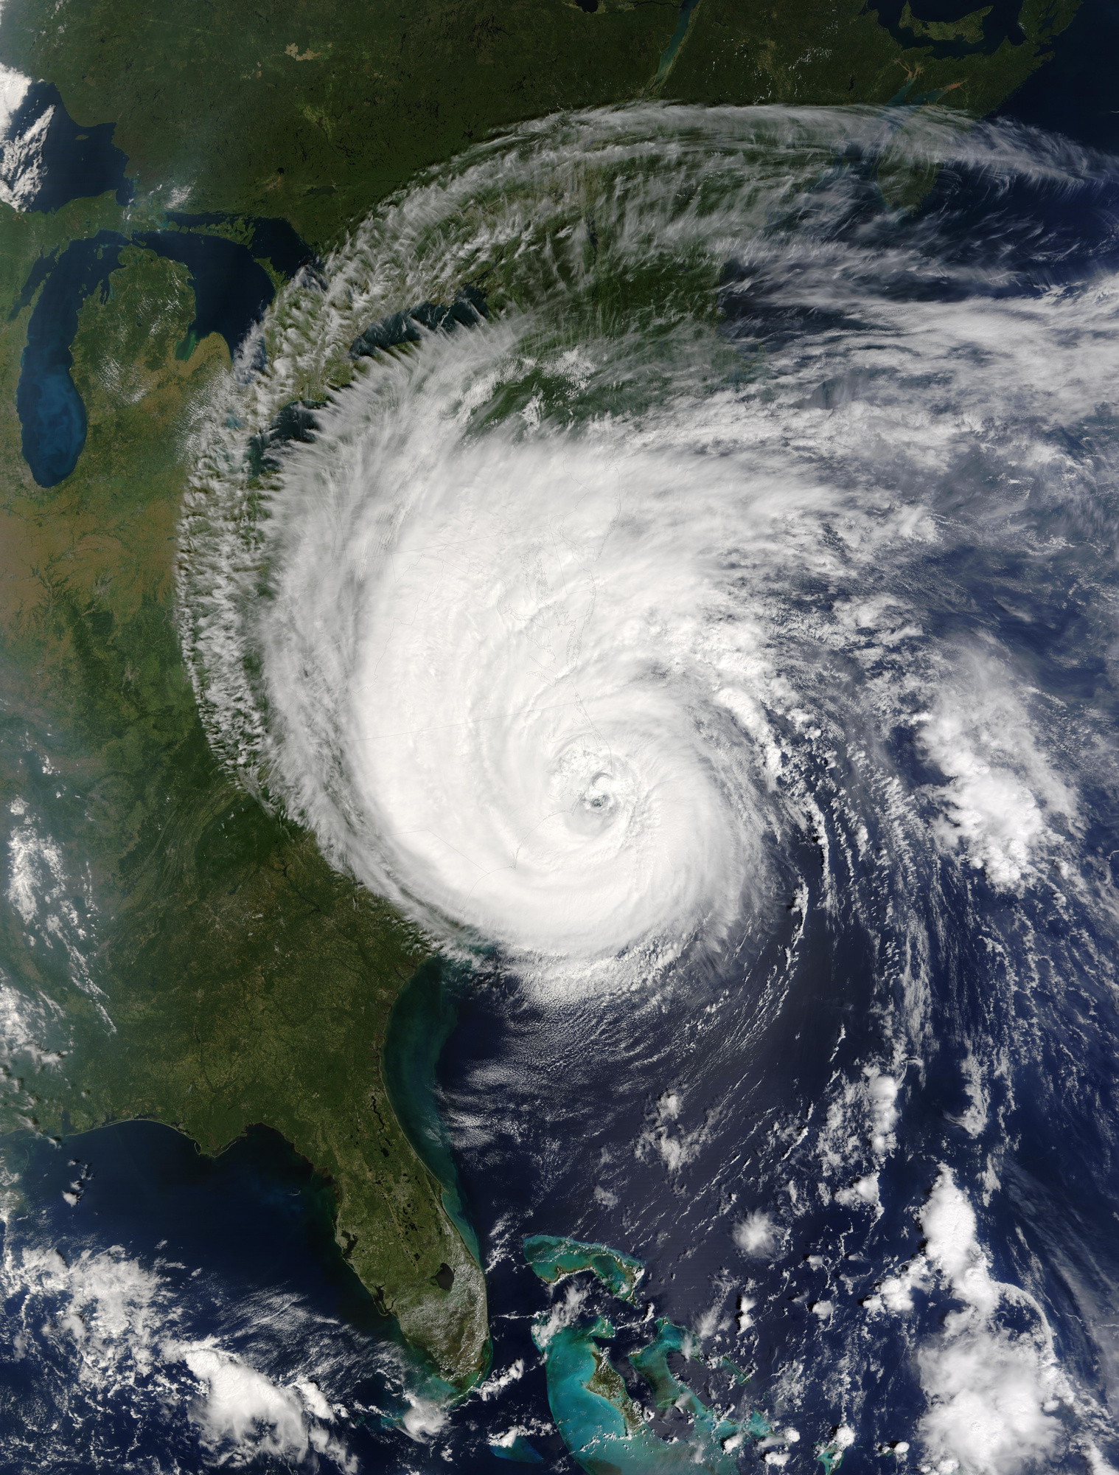



THANK YOU!

